Slide 1



Deploying Microservices
using AWS Compute
Arun Gupta
Principal Technologist
argu@amazon.com
@arungupta
arun-gupta
Tiffany Jernigan
Developer Advocate
tfj@amazon.com
@tiffanyayj
tiffanyfj
Notes:
With Serverless, there are as many architecture patterns and best practices as there are customer. What we’ll show today is what our customers are using.

Slide 2
Agenda
Introduction
Build Your Application
Microservices using AWS Fargate and Amazon ECS
Microservices using Kubernetes
Microservices using AWS Lambda

Slide 3
Introduction

Slide 4
What Are Microservices?
“A software architecture style in which complex applications are composed of small, independent processes communicating with each other using language-agnostic APIs. These services are small, highly decoupled and focus on doing a small task, facilitating a modular approach to system-building.” - Wikipedia
https://en.wikipedia.org/wiki/Microservices

Slide 5
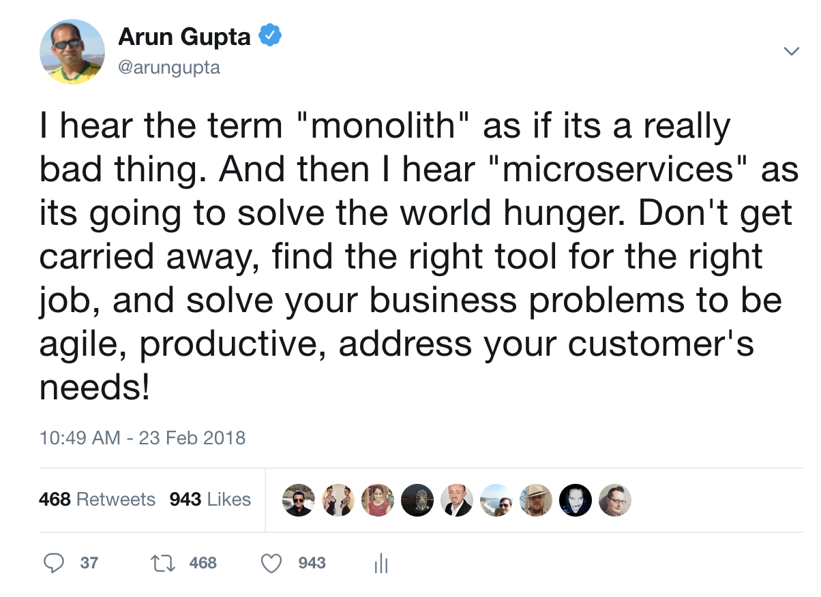

Slide 6
Application Concerns
Dev
Language & Framework
Packaging
Local dev, test, debug
Identify bottlenecks
Logging & Monitoring
Launch is the start line
Release new versions
Deployment pipeline
Dev prod parity
Ops
Keep application stable
Repository for storing artifacts
Scale, patch, upgrade
Infrastructure
Deployment pipeline
Dev prod parity

Slide 7
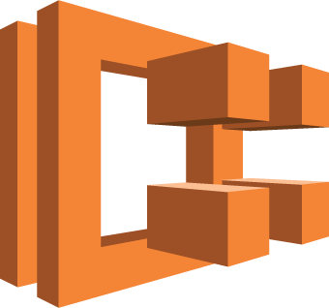
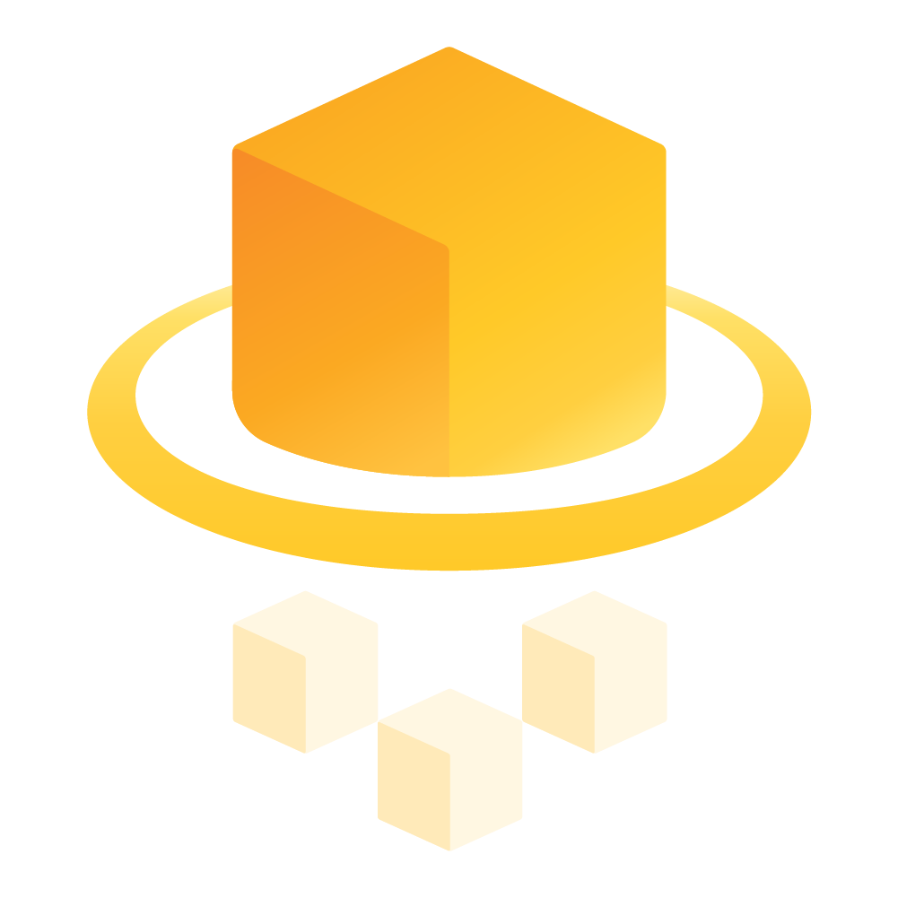









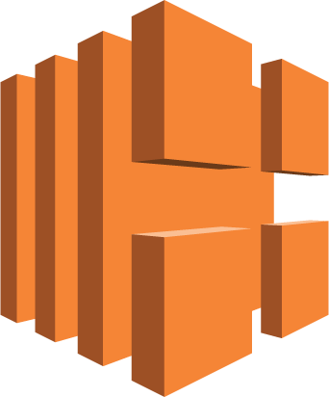







Building Blocks for Containerized Microservices
Compute
Storage & Database
Amazon ECS
AWS Fargate
AWS Elastic Beanstalk
Amazon DynamoDB
Amazon S3
Amazon ElastiCache
Amazon RDS
Amazon ECR
Amazon EKS
Application Integration
Networking & API Proxy
Amazon SQS
Amazon SNS
Amazon MQ
AWS Step Functions
Elastic Load Balancing
Amazon Route 53
Amazon API Gateway
Developer Tools
Logging & Monitoring
AWS Cloud9
AWS CodeBuild
AWS CodePipeline
Amazon CloudWatch
AWS CloudTrail
AWS X-Ray

Slide 8
A Typical Application with Microservices
Client
Webapp
Webapp
Webapp
Greeting
Name
Greeting
Name
Greeting
Name

Slide 9
Build Your Application

Slide 10

Eclipse Microprofile
Defines open source Java microservices specifications
Multiple implementations: supported by many app servers
Aligns with Java EE (and Jakarta EE), but not require it
Quarterly releases
Under discussion/planning: service mesh support and more
JSON-P 1.0
Common Annotations
Health Check
Config
Open API
REST Client
CDI 1.2
JAX-RS 2.0
Fault Tolerance
Metrics
Open Tracing
JWT Propagation
Notes:
MicroProfile was founded in mid-2016 as a means to accelerate adoption of microservices within the Enterprise Java community. Community is at its core, with specifications being collaboratively defined and led by individuals and organizations. No single organization
MicroProfile specifications can be used outside of traditional Java EE application servers, and Hammock an example. However, MicroProfile implementations are often used to extend the capabilities of Java EE application servers. This shows a nice alignment with Java EE while also enabling innovation outside of Java EE.
MicroProfile specifications address Microservices/Cloud Native architectural patterns. CDI, JSON-P, and JAX-RS form the foundation of the programming model, so MicroProfile is ideal for those with a Java EE background. Red Hat is very active in the MicroProfile community. MicroProfile borrows a minimal set of Java EE-related specifications (CDI, JSON-P, JAX-RS, common annotations) to define a base programming model and then utilizes that foundation to define specifications around cloud native development patterns. MicroProfile uses a very lightweight process to introduce (incubate) new projects and move them along into the core MicroProfile platform. Once in the platform, the lightweight process can be utilize to quickly evolve a specification. For example, a number of MicroProfile specificaitons have already gone through multiple updates within the last year.
There is a constant pipeline of new capabilities being introduced. Right now working groups are being formed around supporting service meshes (like Istio and LInkerd) and distributed messaging. MicroProfile 2.0 is targeting a core platform update from the prior Java EE 7-related APIs to their Java EE 8 equivalents, with a plan to add JSON Binding as well.

Slide 11

WildFly Swarm
Leverage Java EE expertise
Open standard
Microservices focus
Super Lightweight
Uber-jar and WAR support
My Svc
JAX-RS
java -jar my_microservice.jar
Notes:
WildFly Swarm wants to enable organizations to leverage their Java EE knowledge when moving to cloud native development. It does so by re-thinking of the execution environment - containerized applications in an orchestrated (Kubernetes) environment. Many of the management features typically offered by application servers are now provided by containerized environments. WildFly Swarm replaces traditional appserver features and instead exposes features and capabilities that enable the container environment to more easily manage and monitor applications.
As an open source project that supports Java EE and MicroProfile specifications, WildFly Swarm maintain's Red Hat's core values in open source and industry standards, enabling customers to improve customer choice while simultaneously reducing risk.
WildFly Swarm supports both Uber jars and traditional war file deployments. The uber-jar approach includes both application and just enough of the appserver to run the application. This is ideal for organizations that prefer a self-contained distributed "executable". Traditional war file deployment are for those that prefer to optimize for containerized environments.

Slide 12
Hollow Jars – Customize your app server
Define a set of Maven dependencies (swarm.hollow=true) …
… without the application .war file
Package them into an uber jar
Pass in the WAR on CLI
Benefits
Enforcing corporate standards
Ideal for containerization
application.war
Hollow JAR
Java / JDK
Base Linux Image
Linux Kernel
java -jar custom_runtime.jar myapp.war
Notes:
Swarm applications can be delivered as uber-jars. However, developers can create their own custom application server by only including the parts of the appserver that are required following corporate standards, and packaging that into an uber jar. This is done easily by defining the desired maven dependencies and then defining the "swarm.hollow=true" maven plugin property. That uber jar can then be added to a container layer and shipped to each docker host only once, enabling reuse. The application is then layered on top of the custom appserver hollow jar, making deployments smaller and much quicker build, ship, and deploy.

Slide 13
Application Code

Slide 14
Local Testing using Maven

Slide 15
Microservices and Containers

Slide 16
Microservices and Containers
Do one thing, really well
Any app, any language
Test and deploy same artifact
Self-contained services
Isolated execution environment
Faster startup
Scaling and upgrading

Slide 17

Running Container
Notes:
Getting started with containers is rather easy, you could even spin up one locally without much effort

Slide 18
Docker Packaging

Slide 19
Testing Containers Locally

Slide 20


Running Containers
EC2 Instance
EC2 Instance
EC2 Instance
EC2 Instance
EC2 Instance
Notes:
Or if you want to run containers in the cloud, you spin up some EC2 instances, launch containers on them and get going in minutes. This would work even if you are using dozens of containers. But as you think about scaling this, managing hundreds of such instances, monitoring their health, scaling them and launching your containers on them and the whole lifecycle around them…how do you scale for that?

Slide 21
Running Containers at Scale
Scheduling and Orchestration
Cluster Manager
Placement Engine
Availability Zone #1
Availability Zone #2
Availability Zone #3
Notes:
So lets say you plan to run several highly available applications across 3 different availability zones.
[CLICK]
ECS enables you to be able to operationalize your containerized workloads at very high scales. No management software to install or worry about its high availability.
The cluster management piece enabled you to be able to monitor the cluster, scale it using autoscaling groups and be able to manage state of the instances in the cluster.
The placement engine enables you to be able to set rules to target landing your containers on the right instances based on your preferences.
And then finally, the advanced scheduling features help maintain the desired state of the application, spawn new containers to automatically respond to scaling needs and maintain resiliency by deploying across multiple availability zones while being resource aware of the underlying compute.

Slide 22
AWS Fargate and Amazon ECS

Slide 23






Running Containers on AWS
Using Managed Services
(Limited Preview)
Notes:
It was just over 3 years ago that we announced the release of Amazon Elastic Container service We launched ECS because our customers needed a way to manage and scale the deployment of Docker containers on AWS. Our customers wanted a managed service where they didn’t have to operate their own cluster management software, a solution that was scalable and secure that they could trust to run their production workloads, and they wanted tight integration and support for EC2 features that they liked.
Then in 2015, we focused on building a highly reliable, and performant docker image registry and announced this GA release near the end of 2015. Our goal with ECR was to enable developers to use the same familiar docker push/pull APIs to store their container images and we see this product highly adopted by customers both running containers on AWS and really across any environment.
What have we learned since then?

Slide 24
Helping Customers Scale Containers
450+% growth
Hundreds of millions of containers started each week
millions of container instances
Notes:
In the last couple of years we have seen great adoption of production use cases on Amazon ECS. Our active users are up by more than 450% since 2016 and we are managing containers across millions of instances each month.
In fact, we are witnessing an incredible transition to containers and customers of ECS, whether its Expedia running its travel platform or Mapbox powering mapping data for some of the most popular websites, Amazon ECS enables these customers to be able to run containers at scale. And indeed, we see hundreds of millions of containers launched every week.

Slide 25

Compute Consumption Model
=
No instances to manage
Task native API
Resource based pricing
Simple, easy to use, powerful – and new consumption model
Notes:
With Fargate:
You have no instances to manage: no more patching OS or runtimes
With the new Task Native API, you don’t need to worry about clusters (they are their as an organizational and security boundary), but you don’t need tow think about cluster utilization or Auto Scaling of compute resources within the cluster.
With the resource based pricing model you only pay for the resources you provision for each task.
We think Fargate fundamentally changes how you think about consumption; how you will run and deploy your applications with containers.

Slide 26
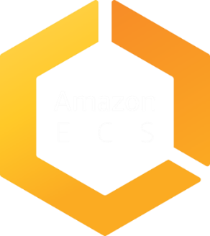
Production Workloads on AWS
AWS VPC networking mode
Advanced task placement
Deep integration with AWS services
ECS CLI
Global footprint
Powerful scheduling engines
Auto scaling
CloudWatch metrics
Load balancers
…
{
}
Notes:
To ensure we can support every workload, we’ve provided containers running on Amazon ECS deep integration with the breadth of AWS platform features and capabilities to make it easier to run container-based applications in production. These integrations include support for AWS VPC task networking, IAM roles and Security Groups for tasks, Load Balancer support (ELB, ALB, NLB), Task Auto Scaling for clusters and Tasks, and CloudWatch Metrics and Logs.
We also provide a rich set of developer tools to make it easier to build complex applications on AWS, including integration with AWS CodePipeline and the ECS CLI which offers a simplified, yet powerful, user experience for getting started with ECS.
With ECS and Auto Scaling, customers can run applications that can grow to support cloud-scale applications.

Slide 27
Create ECS Cluster
Notes:
Create a cluster in us-east-1
Talk about support for Windows containers

Slide 28
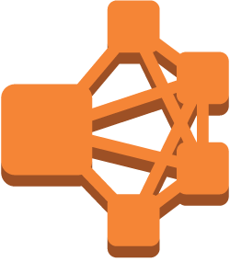



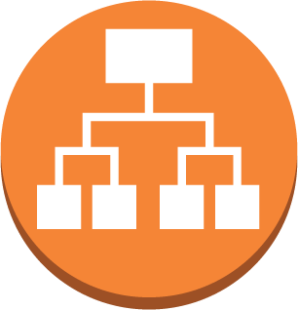
ECS Constructs
Elastic Load Balancer
run
Task
create
Service
A running instantiation of a task definition
Use FARGATE launch type
Maintain n running copies
Integrated with ELB
Unhealthy tasks automatically replaced
register
Task Definition
Define application containers: Image URL, CPU & Memory requirements, etc.
create
Cluster
Infrastructure Isolation boundary
IAM Permissions boundary
Notes:
Task definition is like a blueprint to the recipe of your task. It includes all the relevant parameters for the container set that you want to run.
Cluster serves as logical abstraction to organize your tasks together, as well as administrative boundary for permissions and isolations. For example, you can setup IAM policies to prevent particular users to be able to run, or not, in a cluster. You can also permission it down to a limited set of resources.
Task is an instantiation of the task definition. This is where you specify runtime parameters such as Fargate or EC2.
Tasks are great, but often you want multiple copies of a task running. And a task may fail as well. That’s why we’ve the concept of Service. This is like ASG in EC2. You can ELB, ALB and NLB to load balance your tasks running in the service.

Slide 29
Task Definition
Task Definition Snippet
Immutable, versioned document
Identified by family:version
Contains a list of up to 10 container definitions
All containers are co-located on the same host
Each container definition has:
A name
Image URL (Amazon ECR or Public Images)
{
"family": ”greeting",
"containerDefinitions": [
{
"name": "name",
"image": "arungupta/greeting:latest",
"cpu": "256",
"memory": "1024",
"essential": true,
"portMappings": [
{
"hostPort": ”8081",
"containerPort": ”8081",
"protocol": "tcp"
}
]
}
]
}
Notes:
As mentioned earlier, task definition are like blueprints of your application.
Family provides a friendly way to reference a document with a specific version.
Next, we have containerDefinitions block that define the list of containers that should run as part of this task. Containers defined in the task start at the same time and co-located on the same host.

Slide 30
Task Definitions
Notes:
Show taskdefs from https://github.com/aws-samples/aws-microservices-deploy-options/tree/master/apps/ecs/ec2/taskdefs

Slide 31

EC2 Instance
ECSTask
ECSTask
ECSTask
ECSTask
ECS agent
Docker agent
ECS AMI
Notes:
If you double click on the instances it reveals that there is additional supporting software that you need to run, maintain and patch on ALL your virtual machines to support your containers like the Docker daemon and ECS Agent.

Slide 32
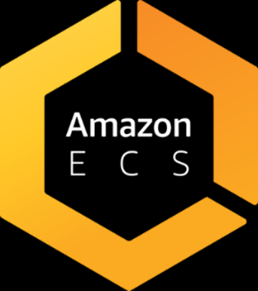


Scheduling and Orchestration
Cluster Manager
Placement Engine
EC2 Instance
EC2 Instance
EC2 Instance
ECS agent
Docker agent
ECS AMI
ECS agent
Docker agent
ECS AMI
ECS agent
Docker agent
ECS AMI
Notes:
So the real picture looked something like this. There are these additional layers of management you need to be aware of when all you wanted to do was run containers!
[CLICK]
Fargate support for ECS enables you to do just that – fully managed orchestration as well as data plane experience bringing your focus to only containers.

Slide 33
Running Containers with ECS
Notes:
So let’s talk about how to use FARGATE with ECS. You want to think about Fargate as a technology and not a different service per se when using it with ECS. I.e. no new APIs to learn.
[CLICK]
Here’s a screenshot of ECS when you define an application (called a Task Definition), you are presented with an option to select compatibilities with a launch type – Fargate is just a launch type. If you want to run your containers on the EC2 Instances registered with your ECS cluster, that is the EC2 Launchtype.
====================
For example a runtask command has a new launchtype: ecs run-task --launch-type FARGATE --cluster fargate-test --task-definition nginx --network-configuration "awsvpcConfiguration={subnets=[subnet-b563fcd3]}"

Slide 34
Running Fargate Containers with ECS
Same Task Definition schema
Use ECS APIs to launch Fargate Containers
Easy migration – Run Fargate and EC2 launch type tasks in the same cluster
Notes:
So you continue to define your applications as you do for ECS today and use the SAME Apis. Running containers as Fargate or EC2 is really a launch time decision. There is no additional plugin to be added to run your containers as Fargate.
And because you can continue to leverage the same constructs and APIs, not only is your migration between EC2 and Fargate easy but you can run a Fargatized service and one that runs on your EC2 instances side by side within the same cluster. So you get flexibility in picking the launch type for your purposes without breaking the model of co-location of your apps.

Slide 35
Deploy Fargate Containers

Slide 36
AWS Fargate Visibility and Monitoring
CloudWatch Logs CloudWatch Events supported
Service-level metrics available
Notes:
All application logs are sent to the CWL and CWE available in customer account.
Amazon ECS event stream for CWE can be used to receive near real-time notifications regarding the current state of your Amazon ECS clusters.
In addition when you want to setup scaling rules for your services, you can monitor the ServiceCPU and ServiceMemory utilization.

Slide 37
Logging for AWS Fargate Containers
Notes:
Select webapp-service, show Metrics and Logs tab in the Cluster
Highlight integrated CloudWatch

Slide 38
Rightsize your microservices with AWS Fargate

Slide 39

Cluster Level Isolation
PROD CLUSTER
BETA CLUSTER
Web
Shopping Cart
Notifications
Notifications
Web
Shopping Cart
Shopping Cart
Notifications
PROD Cluster Infrastructure
BETA Cluster Infrastructure
DEV CLUSTER
QA CLUSTER
Web
Web
Shopping Cart
Shopping Cart
Web
Web
Notifications
Notifications
DEV Cluster Infrastructure
QA Cluster Infrastructure
Notes:
You continue to use the notion of a cluster when using Fargate with ECS. With Fargate, even though there are no EC2 instances to run, a cluster is an entity to provide logical isolation.
In ECS with EC2, your container instances are registered with a cluster and your tasks are running on shared infrastructure.
[CLICK]
Similarly your Fargate tasks in the prod cluster MAY share the same underlying infrastructure as other tasks within the same cluster. But the Notification application in PROD will never share the infrastructure with any other tasks from the DEV, QA or BETA clusers.

Slide 40
Pricing Dimensions
{
”cpu": “1 vCPU”,
”memory": “2 gb”,
"networkMode": ”AWSVPC",
"compatibilities": [”FARGATE", ”EC2"],
"placementConstraints": [],
"containerDefinitions": [
{
<snip>…....
Dimensions: Task level CPU and memory
Task Level Resources
Per-second billing
Task level resources
Configurable independently (within a range)
Notes:
Running the ECS orchestration in itself continues to be at no additional charge, you only pay for what you request at the Task Level. Here we have defined Task level CPU and Memory at 1vCPU and 3GB respectively. You get what you define at the Task level and are charged on a per second basis and only for the time your task is in use. This CPU and memory is applied to all the containers in the task. These are the only required resource parameters when creating a task meant for Fargate. Container-level resources are still available but are now optional.
The billing is on a per second granularity and you configure and pay for the task level dimensions independently. In other words, you pay per CPU-second and per GB second for memory. The billing starts from when the Docker image starts to download.

Slide 41
Task CPU & Memory Configurations
Flexible configuration options – 50 CPU/memory configurations
CPU | Memory
256 (.25 vCPU) | 512MB*, 1GB, 2GB
512 (.5 vCPU) | 1GB to 4GB (1GB increments)
1024 (1 vCPU) | 2GB to 8GB (1GB increments)
2048 (2 vCPU) | 4GB to 16GB (1GB increments)
4096 (4 vCPU) | 8GB to 30GB (1GB increments)
Notes:
Here are the various configurations supported today with Fargate. As you can see, you can have from 2GB per vCPU to generally up to 8GB per vCPU for various configurations. Match your workload requirements closely whether they are general purpose, compute or memory optimized. You only pay for per-second basis with a one-min minimum.
You can look at the Fargate website for exact pricing levels

Slide 42

© 2017, Amazon Web Services, Inc. or its Affiliates. All rights reserved.
Notes:
So you may ask, with Fargate and EC2 launch types available, which one should I pick for workloads? Or if you say that I like the simplicity of Fargate but when should I when should I think about using the EC2 launch type?
How much you want to manage? Do you want to use OD or Spot Instances? Do you have specific memory/compute requirements? The key to understanding is that it is not a one-way door, you can go back and forth as the schemas are compatible and the administrative boundary is still the same ECS cluster.

Slide 43
Amazon ECS CLUSTER
Subnet 1
Subnet 2
Subnet 3
172.31.1.0/24
172.31.2.0/24
172.31.3.0/24
Web
FARGATE
Shopping Cart
ECS Instance
ECS Instance
ECS Instance
ECS Instance
ECS Instance
ECS Instance
Notifications
EC2
Availability Zone #1
Availability Zone #2
Availability Zone #3
Notes:
Fargate clusters are heterogeneous.
Say you have different requirements where the notifications app team would like to be able to move to Fargate but has a different timeline planned to do so but are ready to use Fargate for your Shopping cart and web apps.
[CLICK]
As you notice, you can run the Web and shopping cart apps as ECS services with launch type Fargate and you only see your tasks across the various subnets and AZs. You can continue to run Shopping Cart and Notifications apps as EC2 Launch Types within the same cluster as the Fargate powered Web app and network boundaries thereby applying uniform set of policies in terms of IAM permissions as well as network access rules.
Notice, how the containers are spread across different subnets across AZ. This gives high resiliency and fault tolerance to your microservices.

Slide 44
Deployment Pipelines with AWS CodePipeline
Notes:
Amazon.com had the same problem as our customers and developers. Amazon.com is built as a set of 100s of microservices, we needed tools to automate the deployments. How do we do frequent deployments, like 50m changes (1.5 deployment/sec, i.e. 4k deployments during our 45 min talk) a year in 2014. Internal tools have inspired the CodeStar family.

Slide 45
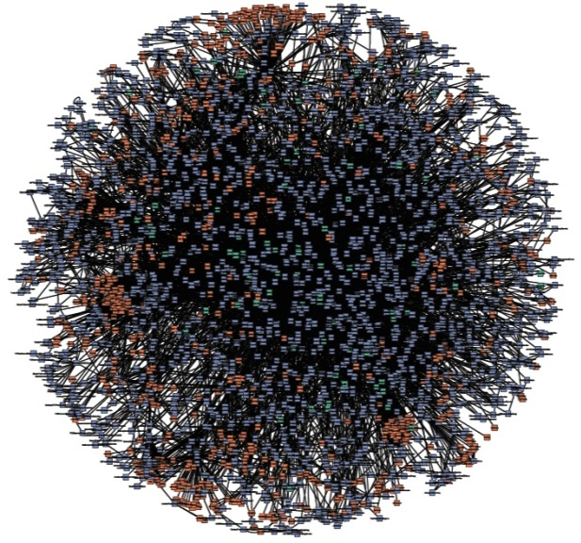
Single-purpose
Connect only through APIs
Connect over HTTPS
Largely “black boxes” to each other
“Microservices”

Slide 46
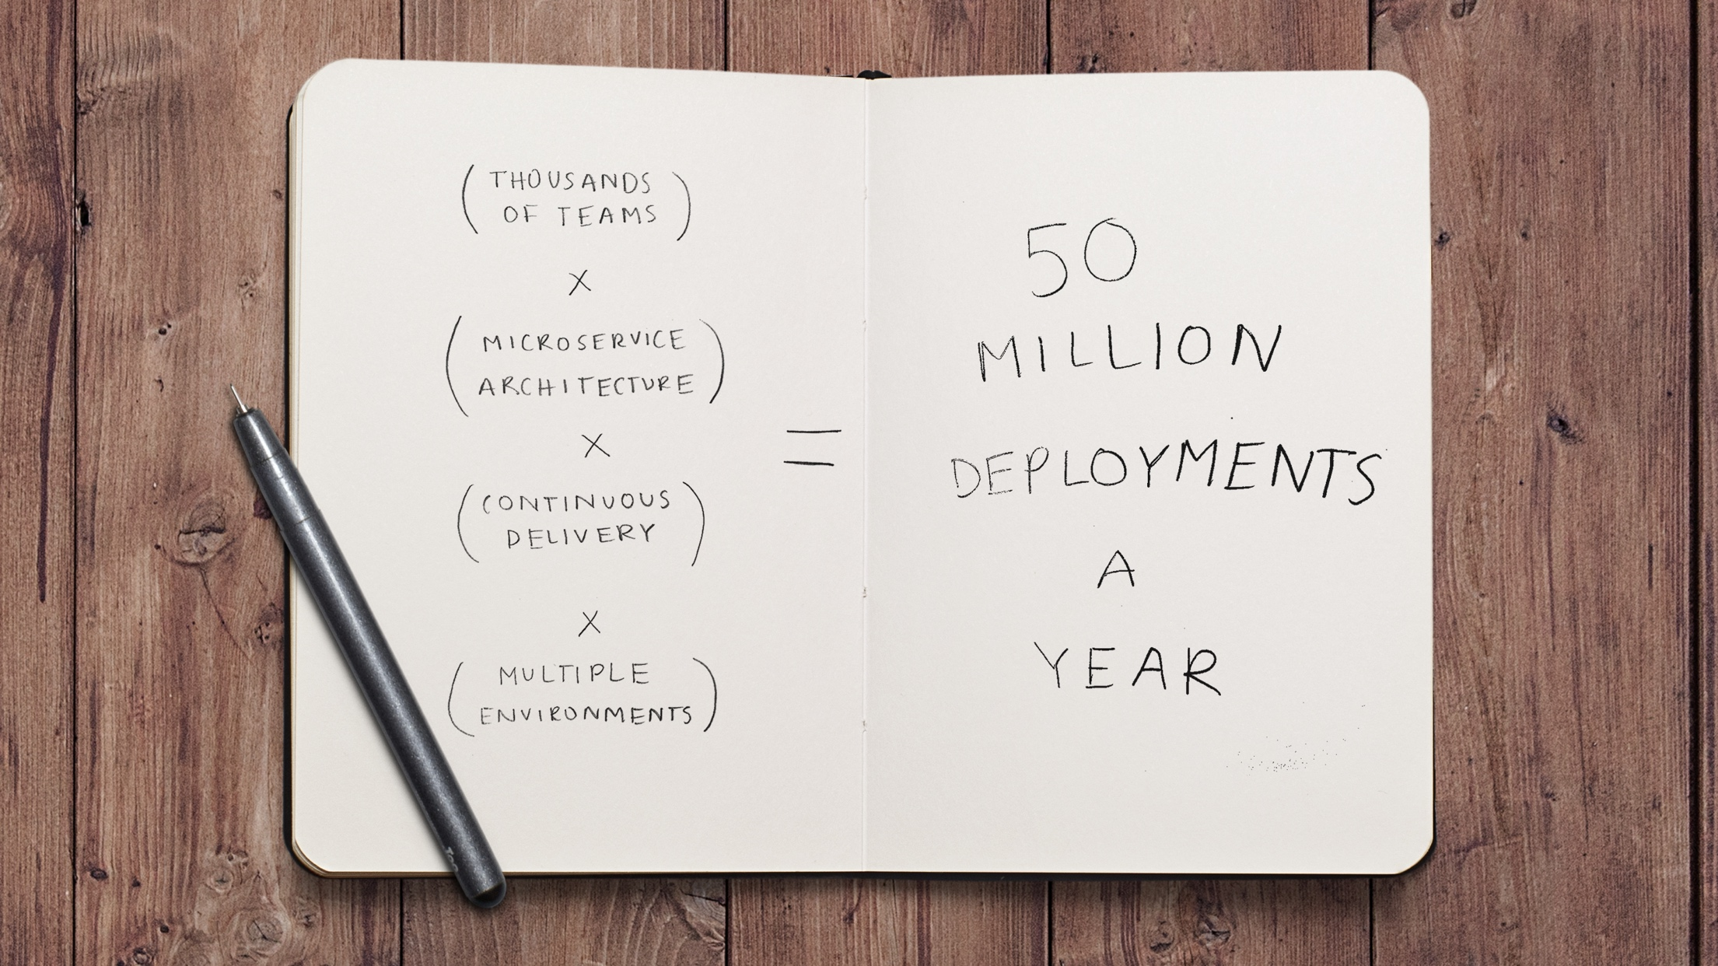

Notes:
Code Pipeline was created because of this requirement.

Slide 47




Deployment Pipeline with AWS Fargate
5
1
Developers continuously integrate changes into a main branch hosted within a repo
Amazon ECR
2
Triggers an execution of the pipeline when a new version is found, builds a new image with build ID
3
4
3
Pushes the newly built image tagged with build ID to ECR repo
4
Creates a new taskdef revision using the image built
1
2
Developer
GitHub
AWS CodeBuild
5
Fetches new container image and updates the deployment
AWS CodePipeline
Notes:
https://aws.amazon.com/blogs/compute/continuous-deployment-to-amazon-ecs-using-aws-codepipeline-aws-codebuild-amazon-ecr-and-aws-cloudformation/
https://github.com/aws-samples/aws-microservices-deploy-options#deployment-pipeline-fargate-with-aws-codepipeline

Slide 48
Deployment Pipeline for
Fargate Containers with
AWS CodePipeline
Notes:
https://github.com/aws-samples/aws-microservices-deploy-options#deployment-pipeline-fargate-with-aws-codepipeline

Slide 49
Monitoring

Slide 50
Metrics
Visualizer
Grafana, Kibana, Dashboard
Alerting
AlertManager, Kapacitor
Cluster-wide Aggregator
Prometheus, Heapster
Nodes Node exporter
Pod/Container
Kube-state-metrics
cAdvisor
Application
/metrics
JMX
Data Model
InfluxDB, Graphite
Notes:
Tune the Docker logs in different manner
System logs
Docker logs
Pod has a PID
PID writes to STDOUT
Docker picks it up and dumps to file
Debian: daemon.log
System log (systemd logs): Kernel panics, messages from Docker, kubelet, API server
Why my pod is not scheduling? - Kubectl events, kubectl describe will help
Basic is throw Prometheus – aggregator for events, not a long term persistent store – Actually InfluxDB comes with scaling and clustering only in the commercial version. The open source version like Prometheus has to be manual sharded and scaling has to be figured out based on how much data is gathered.

Slide 51
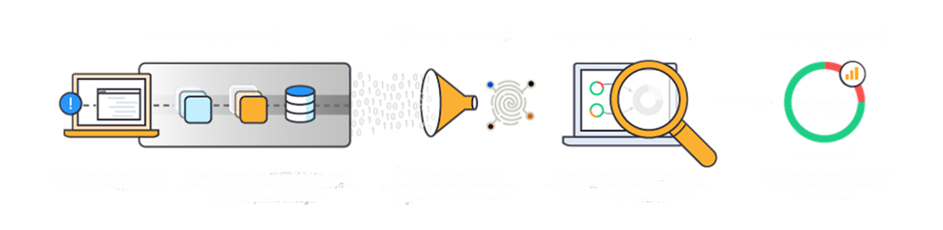
X-Ray Service
Notes:
X-Ray helps you with tracing requests, record the traces in the X-Ray service, view service map of your distributed application in the X-Ray console and analyze specific issues that are affecting your application within a specific time frame.

Slide 52
X-Ray SDK
Available for Java, .NET, .NET Core, Python, Ruby, Go, Node.js
Adds filters to automatically capture metadata for calls:
AWS Services using the AWS SDK
Non-AWS services over HTTP and HTTPS
Database (MySQL, PostgreSQL, Amazon DynamoDB)
Queues (Amazon SQS)
Enables you to get started quickly
Source: https://github.com/aws?q=xray-sdk
Notes:
X-Ray SDK is available for Java, .NET, .NET Core, Python, Ruby (beta), Go (RC1) and Node.js.
AWS services called using AWS SDK can be automatically instrumented.
Non-AWS services over HTTP and HTTPS can be instrumented
Driver available for MySQL and Postgres
It enables you to quickly instrument your application code to index data using annotations and log data using metadata.

Slide 53










X-Ray Workflow
X-Ray Console
DevOps Team
HTTPS
App & X-Ray
SDK
Localhost
UDP
HTTPS
HTTPS
Localhost
UDP
App & X-Ray
SDK
X-Ray
AWS
Credentials
X-Ray
Daemon
X-Ray
Daemon
EC2 Role
On-prem Server
EC2 Instance/Containers/Lambda
Notes:
The X-Ray daemon listens on UDP. It receives data from the SDK over UDP and acts as a local buffer. Data is flushed to the backend every second or when the local buffer fills. Daemon available for Amazon Linux AMI, RHEL, Ubuntu, OS X, and Windows.
Daemon talks to the X-Ray API/service over HTTPS.
You can use X-Ray on your on-prem servers by running the X-Ray daemon as well.
You can then view and analyze performance of your distributed application in the X-Ray console.
Pre-installed on Lambda

Slide 54
X-Ray Daemon
Available for Amazon Linux AMI, Ubuntu, OSX, Windows
Multiple deployment options: EC2, ECS, On-prem, Laptop
Pre-installed on AWS Lambda
https://github.com/aws/aws-xray-daemon
Enables integration with other tools and tracing systems
Notes:
Receives data from the SDK over UDP and acts as a local buffer
Data is flushed to the backend every second or when the local buffer fills

Slide 55




How Does AWS X-Ray help?
Identify Performance Bottlenecks
Pinpoint Specific Service Issues
Identify Errors
Identify Impact to Users
Notes:
X-Ray helps with:
Identifying performance bottlenecks in your distributed application.
Pinpoint specific service issues such as server faults (5xx) or throttling issues.
Identify 4xx errors and reasons for those errors.
Identify impact to end-users such as who is affected and the issues affecting them.

Slide 56



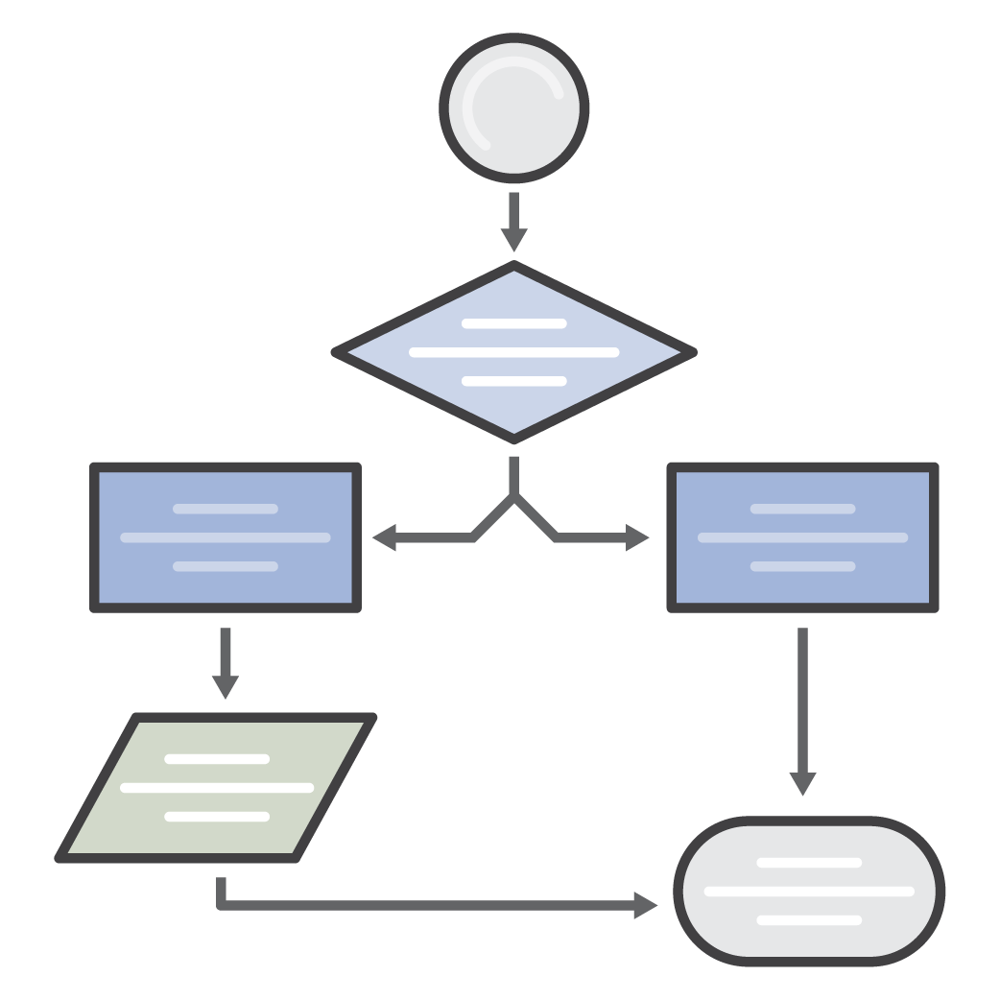



Advanced Use Cases
Use Off-Cloud
Custom Payload
Deep Linking
Filter Expressions
Custom Apps via API
Notes:
Use X-Ray off-cloud on your on-prem servers using the X-Ray daemon and SDK.
Add custom payload to your headers or annotations or metadata.
Deep-link X-Ray console to view specific traces in your solutions.
Create specific filter expressions to filter and view specific traces.
Create your own custom apps using X-Ray APIs to view and analyze performance issues.

Slide 57
Monitoring ECS Containers
using AWS X-Ray

Slide 58
Microservices using Kubernetes

Slide 59


What is Kubernetes?
Open source container management platform
Helps you run containers at scale
Gives you primitives for building modern applications
Notes:
The first thing we need to do is introduce Kubernetes. Kubernetes has been around for a few years now, but it has absolutely taken the world by storm, especially over the past 12 months. It’s also rapidly gained traction amongst AWS customers.
So, strip away the hype, and at its core, Kubernetes is an open-source container management platform. It’s built to help you run your containers at scale and comes equipped with features and functions to build proper distributed applications using the 12-factor app pattern.

Slide 60

57%
of Kubernetes workloads run on AWS today —CNCF survey
Notes:
Our customers believe that there are tremendous advantages to running Kubernetes on AWS. According to a CNCF survey this year, over 60% of Kubernetes workloads run on AWS today. This is entirely organic growth fueled by strong community of developers, customers, and partners.
Let’s take a quick look at what your typical Kubernetes on AWS deployment looks like.

Slide 61
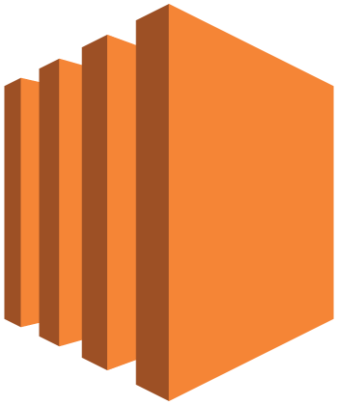
Kubernetes on AWS
3x Kubernetes masters for HA
Notes:
Customers generally run 3 Kubernetes masters across three availability zones to provide a highly available Kubernetes control plane. Each Kubernetes master runs a copy of the same components.
There are some customers that run single-AZ control planes, as well.

Slide 62
Kubernetes master
API server
Controller manager
Cloud controller
Scheduler
KubeDNS
Add-ons
Notes:
The Kubernetes masters run several components within them- the API Server, which is fairly self explanatory, the controller manager, which runs various system processes for the cluster, and the scheduler, which assigns work to nodes, are some of the main ones. These are the components that allow you to interact with the Kubernetes system.
This is also where add-ons like KubeDNS and the dashboard can run.

Slide 63

Master
Master
Master
Etcd
Etcd
Etcd
Availability
Zone 1
Availability
Zone 2
Availability
Zone 3
Notes:
In addition to the Kubernetes masters, you also need to run etcd, the core persistence layer for Kubernetes. Etcd is a distributed key value store- this is where the critical data for the cluster is stored. You can optionally co-locate the masters and etcd on the same instances, so you only need to run three instances instead of six to support the control plane. This makes tradeoffs in the operational burden when upgrading your cluster, though- you have to make sure that you don’t lose quorum on etcd, or have to reboot instances… This is one of the many complexities you will encounter when standing up your own kubernetes insfrastructure.

Slide 64

Master
Master
Master
Etcd
Etcd
Etcd
Availability
Zone 1
Availability
Zone 2
Availability
Zone 3
Notes:
You then need to run the actual worker nodes- this is where your applications run. Worker nodes are generally deployed in autoscaling groups, across multiple Azs….you can choose OD or RI instances, spot instances, whatever instance type makes sense for you...

Slide 65
“Run Kubernetes for me.”
Notes:
Our customers told us, “Hey, running Kubernetes isn’t trivial work, and we think we can better spend our cycles focusing on our applications.” “if we had things our way, we wouldn’t have to think about the nuances of kubernetes deployments or configuration, we wouldn’t have to worry about managing etcd or the masters” In essence, “run Kubernetes for me”

Slide 66

ELASTIC CONTAINER SERVICE FOR KUBERNETES
Notes:
We listened, and that’s why we’ve built Elastic Container Service for Kubernetes- or EKS.
We know how important a Kubernetes service is to our customers. So we didn't build Amazon EKS haphazardly. An excellent way to communicate how we took your feedback and synthesized it into a service is by taking a look at the core tenets for EKS. These tenets anchored our decision-making for how Amazon EKS should work.

Slide 67
Master
Master
Master
Etcd
Etcd
Etcd
Availability
Zone 1
Availability
Zone 2
Availability
Zone 3
Notes:
So, to recap, one more snapshot of what your standard Kubernetes distribution looks like today. Masters, Etcd, Worker nodes, all running in your acount and under your supervision.

Slide 68
AWS Managed
Master
Master
Master
Customer Account
Workers
Workers
Workers
Availability
Zone 1
Availability
Zone 2
Availability
Zone 3
Notes:
So, to recap, one more snapshot of what your standard Kubernetes distribution looks like today. Masters, Etcd, Worker nodes, all running in your acount and under your supervision.

Slide 69

Kubectl
mycluster.eks.amazonaws.com
Availability
Zone 1
Availability
Zone 2
Availability
Zone 3
Notes:
Now, with EKS, the complexity of standing up your own Kubernetes control plane is simplified. Instead of running the Kubernetes control plane in your account, you connect to a managed Kubernetes endpoint in the AWS cloud. This endpoint abstracts the complexity of the Kubernetes control plane- your worker nodes can check into a cluster, and you can interact with your Kubernetes cluster through the tooling you already know and love.

Slide 70
EKS Cluster

Slide 71
Kubernetes Application Manifest

Slide 72
Kubernetes Application Packaging using Helm

Slide 73
Helm – Package Manager for Kubernetes
Templating and packaging tool for Kubernetes apps
Chart: Bundle to represent k8s applications
Packaged into archive files
Apt, yum, homebrew for k8s
Manage the chart and release

Slide 74
Helm Client
gRPC
Tiller Server
MyApp 1
MyApp 1
MyApp 1
ConfigMap
ConfigMap
chart files
ConfigMap
chart
configuration
Kubernetes API Server
release
Helm Repository
MyApp 1
MyApp 1
MyApp 1
Client manages charts
Server manages releases
chart packages
Notes:
Helm has two parts – client (Helm) and server (Tiller).
Tiller runs inside of your Kubernetes cluster, and manages releases (installations) of your charts.
Helm runs on your laptop, CI/CD, or wherever you want it to run.
Charts are Helm packages that contain at least two things:
A description of the package (Chart.yaml)
One or more templates, which contain Kubernetes manifest files
Charts can be stored on disk, or fetched from remote chart repositories (like Debian or RedHat packages)
The Helm client is written in the Go programming language, and uses the gRPC protocol suite to interact with the Tiller server.
The Tiller server is also written in Go. It provides a gRPC server to connect with the client, and it uses the Kubernetes client library to communicate with Kubernetes. Currently, that library uses REST+JSON. The Tiller server stores information in ConfigMaps located inside of Kubernetes. It does not need its own database.
Configuration files are, when possible, written in YAML.
A chart repository is an HTTP server that houses an index.yaml file and optionally some packaged charts. When you're ready to share your charts, the preferred way to do so is by uploading them to a chart repository. Index.yaml is an index of all of the charts in the repository. It is not required that a chart package be located on the same server as the index.yaml file. However, doing so is often the easiest. Make sure the index.yaml file can be accessed with no authentication requirement
Tiller gets info via the client, when you use stable/spinnaker as the chart it will get the latest bits from one of the repos in your local helm config and sends the interpolated configs to tiller which handles the rest. Repo doesn't need to be configured with tiller, client only do.
Because a chart repository can be any HTTP server that can serve YAML and tar files and can answer GET requests, you have a plethora of options when it comes down to hosting your own chart repository. For example, you can use a Amazon S3 bucket, Github Pages, or even create your own web server.

Slide 75
Helm Chart Structure
Mychart
|-- Chart.yaml
|-- charts
|-- templates
| |-- NOTES.txt
| |-- _helpers.tpl
| |-- deployment.yaml
| |-- ingress.yaml
| `-- service.yaml
`-- values.yaml
Chart defines Kubernetes primitives required to run the application
Variables that are configurable and set to defaults
Printed notes to the user installing the app

Slide 76
Helm Sample Chart
apiVersion: v1
kind: Service
metadata:
name: {{ template "fullname" . }}
labels:
chart: "{{ .Chart.Name }}-{{ .Chart.Version | replace "+" "_" }}”
spec:
type: {{ .Values.service.type }}
ports:
- port: {{ .Values.service.externalPort }}
targetPort: {{ .Values.service.internalPort }}
protocol: TCP
name: {{ .Values.service.name }}
selector:
app: {{ template "fullname" . }}
Yaml file
Mustache templating
Custom functions useful for mutating variables
Shared yaml stored in a separate file
Notes:
Yaml file primitive definitions
Use mustache templating for easy injection of variables
Custom functions useful for mutating the variables included like replace "+" "_"
Shared yaml can be stored in a separate file and merged at deploy template "fullname" .

Slide 77
Helm Chart

Slide 78
Kubernetes Application Packaging using Ksonnet

Slide 79
Ksonnet
Tool for generating and storing Kubernetes manifests using jsonnet
Reduces the amount of copy/paste for your app manifests
Makes it easy to update subsets of your configuration from the CLI

Slide 80
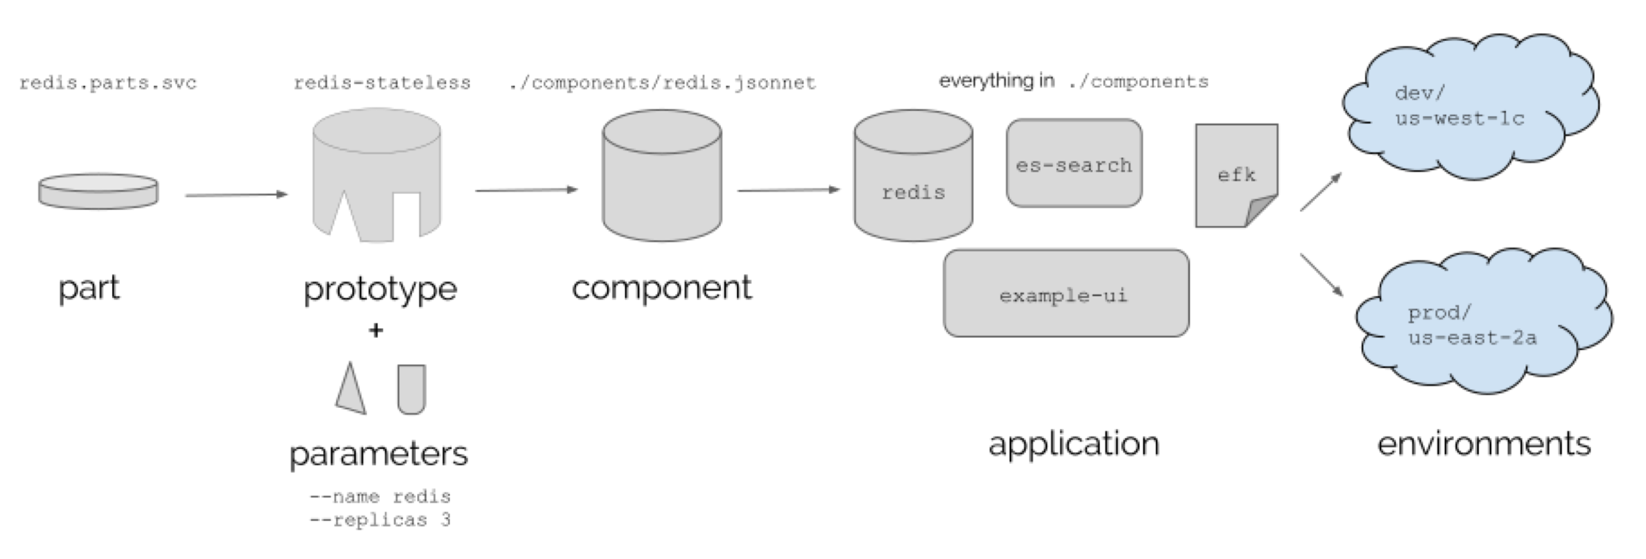
Ksonnet Components
Change the diagram to make it relevant to our application

Slide 81
Ksonnet Components
...
local targetPort = params.containerPort;
local labels = { app: params.name };
local appService = service
.new(params.name,
labels,
servicePort.new(params.servicePort, targetPort))
.withType(params.type);
local appDeployment = deployment
.new(params.name,
params.replicas,
container.new(params.name, params.image)
.withPorts(containerPort.new(targetPort)),
labels);
k.core.v1.list.new([appService, appDeployment])
Component is collection of parts and prototypes for an application
Application deployment defined using jsonnet style syntax

Slide 82
Ksonnet Params
{
global: {
// replicas: 4,
},
components: {
name: {
containerPort: 8082,
image: "arungupta/name",
name: ”name",
replicas: 1,
servicePort: 8082,
type: ”ClusterIP",
}
}
}
A params file declares the configurable components in ksonnet managed application
Params can be changed from the CLI: ks param set name image foo/bar:1

Slide 83
Ksonnet Application

Slide 84
Kubernetes Deployment Pipeline with AWS CodePipeline

Slide 85
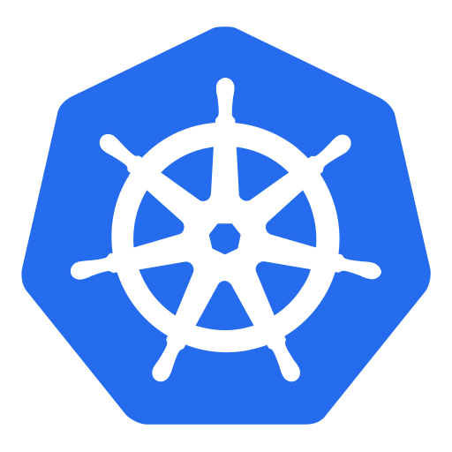
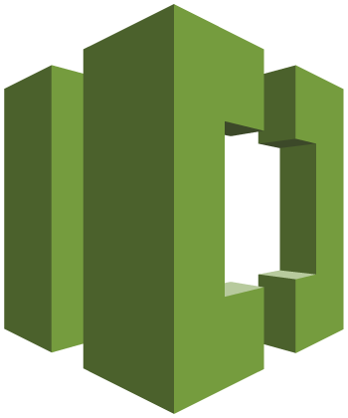
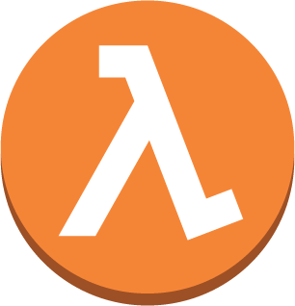
Deployment Pipeline with Kubernetes
6
1
Developers continuously integrate changes into a main branch hosted within a repo
Amazon ECR
2
Triggers an execution of the pipeline when a new version is found, builds a new image with build ID
3
5
3
Pushes the newly built image tagged with build ID to ECR repo
4
Invokes a Lambda function to trigger application deployment
1
2
4
5
Leverages Kubernetes Python SDK to update a deployment
Developer
AWS CodeCommit
AWS CodeBuild
AWS Lambda
6
Fetches new container image and performs a rolling update of deployment
AWS CodePipeline
https://github.com/aws-samples/aws-kube-codesuite

Slide 86
Kubernetes Deployment Pipeline using AWS CodePipeline

Slide 87



Logging using EKS
AWS CloudTrail
Amazon CloudWatch
Master
Notes:
We’ll provide access to our EKS API logs through cloudtrail, Kubernetes control plane logs through cloudwatch like
/var/log/kube-apiserver.log - API Server, responsible for serving the API
/var/log/kube-scheduler.log - Scheduler, responsible for making scheduling decisions
/var/log/kube-controller-manager.log - Controller that manages replication controllers
and, finally, we’ll provide access to the metrics server, which aggregates cluster wide metrics, for consumption via your favorite mechanism.

Slide 88
Kubernetes Logging in EKS

Slide 89
Canary Deployment using Service Mesh
Service-to-service communication
Platform to connect, manage and secure microservices
Any language, any framework
Deployed as “sidecar”
Decouple applications from operational aspects
Service discovery, circuit breakers, routing, tracing, telemetry, etc
No changes to microservices
Fleet-wide policy enforcement
Notes:
Control traffic between services with dynamic route configuration, conduct A/B tests, release canaries, and gradually upgrade versions using blue/green deployments.
Increase reliability by shielding applications from flaky networks and cascading failures in adverse conditions.
Apply organizational policy to the interaction between services, ensure access policies are enforced and resources are fairly distributed among consumers. Policy changes are made by configuring the mesh, not by changing application code.
Understand the dependencies between services, the nature and flow of traffic between them, and quickly identify issues with distributed tracing.
Sidecar proxies enable the decoupling of your applications from the operational aspects of managing service communication effectively and reliably.

Slide 90
Istio
Open platform to connect, manage and secure microservices
Supported on Kubernetes, Nomad and Consul
Notes:
Control traffic between services with dynamic route configuration, conduct A/B tests, release canaries, and gradually upgrade versions using blue/green deployments.
Increase reliability by shielding applications from flaky networks and cascading failures in adverse conditions.
Apply organizational policy to the interaction between services, ensure access policies are enforced and resources are fairly distributed among consumers. Policy changes are made by configuring the mesh, not by changing application code.
Understand the dependencies between services, the nature and flow of traffic between them, and quickly identify issues with distributed tracing.

Slide 91
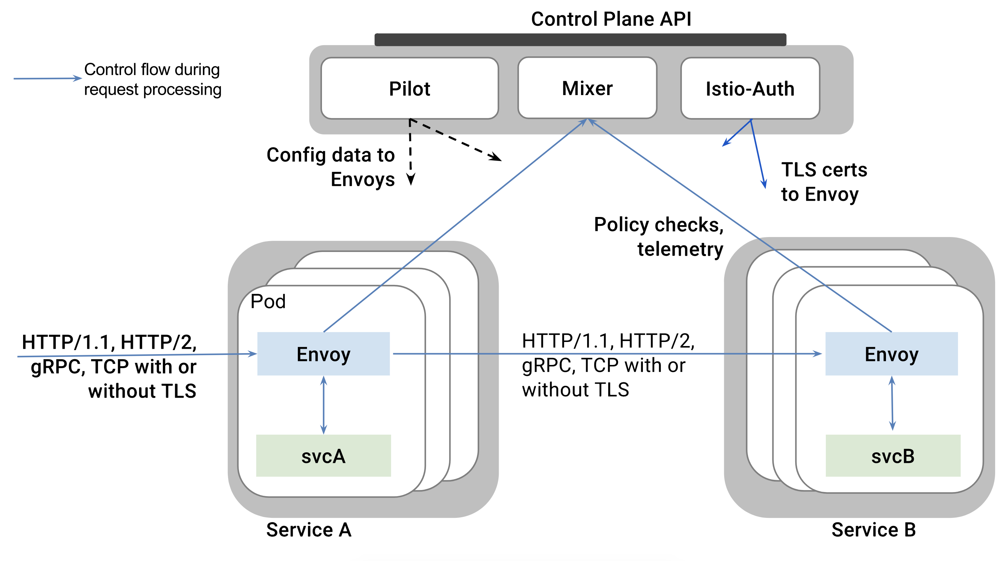
https://istio.io/docs/concepts/what-is-istio/overview.html
Notes:
The data plane is composed of a set of intelligent proxies (Envoy) deployed as sidecars that mediate and control all network communication between microservices.
The control plane is responsible for managing and configuring proxies to route traffic, as well as enforcing policies at runtime.
Istio uses an extended version of the Envoy proxy, a high-performance proxy developed in C++, to mediate all inbound and outbound traffic for all services in the service mesh. Istio leverages Envoy’s many built-in features such as dynamic service discovery, load balancing, TLS termination, HTTP/2 & gRPC proxying, circuit breakers, health checks, staged rollouts with %-based traffic split, fault injection, and rich metrics. Envoy is deployed as a sidecar to the relevant service in the same Kubernetes pod. This allows Istio to extract a wealth of signals about traffic behavior as attributes.
Pilot provides service discovery for the Envoy sidecars, traffic management capabilities for intelligent routing (e.g., A/B tests, canary deployments, etc.), and resiliency (timeouts, retries, circuit breakers, etc.). It converts high level routing rules that control traffic behavior into Envoy-specific configurations, and propagates them to the sidecars at runtime.
Mixer is a platform-independent component responsible for enforcing access control and usage policies and collecting telemetry data from the Envoy proxy and other services. Mixer includes a flexible plugin model enabling it to interface with a variety of host environments and infrastructure backends, abstracting the Envoy proxy and Istio-managed services from these details.
Istio-Auth provides strong service-to-service and end-user authentication using mutual TLS, with built-in identity and credential management.

Slide 92
Canary Deployment using Request Routing
apiVersion: config.istio.io/v1alpha2
kind: RouteRule
metadata:
name: greeting-default
spec:
destination:
name: greeting
route:
- labels:
greeting: hello
weight: 90
- labels:
greeting: howdy
weight: 10
Notes:
Dynamically configured based on weights and HTTP headers

Slide 93
Canary Deployment using Istio

Slide 94
Fault Injection
Can inject delays
Force timeouts of your services
Configure latency and spikes
Other undesirable effects

Slide 95
5 seconds delay in 10% of requests
apiVersion: config.istio.io/v1alpha2
kind: RouteRule
metadata:
name: greeting-delay
spec:
destination:
name: greeting
route:
- labels:
greeting: hello
httpFault:
delay:
percent: 10
fixedDelay: 5s

Slide 96
apiVersion: config.istio.io/v1alpha2
kind: RouteRule
metadata:
name: greeting-delay-abort
spec:
destination:
name: greeting
match:
source:
name: webapp
labels:
version: v2
route:
- labels:
greeting: howdy
httpFault:
delay:
fixedDelay: 5s
abort:
percent: 10
httpStatus: 400
Delay all requests from "webapp v2" to "greeting howdy" by 5s
Abort 10% of requests

Slide 97
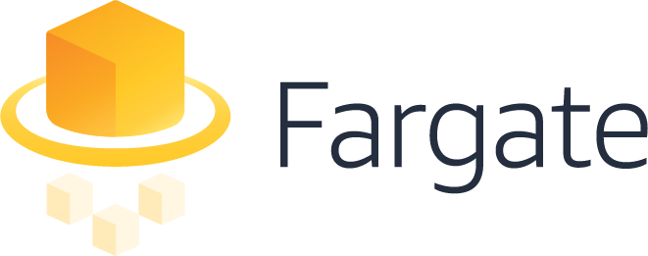

EKS Support for Fargate in 2018
Notes:
We also plan to extend AWS Fargate to support EKS, our fully managed Kubernetes offering, in 2018.

Slide 98
Microservices using AWS Lambda

Slide 99
Serverless Key Concepts

Slide 100




Serverless Tenets
No servers to provision or manage
Scales with usage
Never pay for idle
Availability and fault tolerance built in
Notes:
AWS builds its data centers in multiple geographic regions as well as across multiple Availability Zones within each region to offer maximum resiliency against system disruptions.
Start with Availability (spread across 3 AZs in a region) by default.
Scale with usage. Today a sample application and becomes popular, then it’ll scale with the usage. If the application needs to be launched across the world, then you can add regions.

Slide 101















Spectrum of AWS offerings
“On EC2”
Managed
Serverless
Amazon EMR
Amazon ES
AWS
Lambda
Amazon Cognito
Amazon Kinesis
Amazon EC2
Amazon S3
Amazon DynamoDB
Amazon SQS
Amazon ElastiCache
Amazon Redshift
Microsoft SQL Server
Amazon RDS
Amazon API Gateway
Amazon CloudWatch
AWS IoT
Notes:
Provide context on Region & AZ – 18 regions & 53 AZ
To make HA, On EC2, you need to deploy across different AZ. On Managed, there is an option for multi-AZ. In Serverless, everything (HA & Fault tolerance) is taken care of for you.
First service was S3 and SQS – Serverless services. Lambda was added as Compute to S3 because of customer feedback. And then we added other sources to Lambda.
Provides a wide spectrum of services from Chatbot, IT automation, web application, Alexa and many others. We’ll look at a few of those today.

Slide 102
Lambda Basics

Slide 103

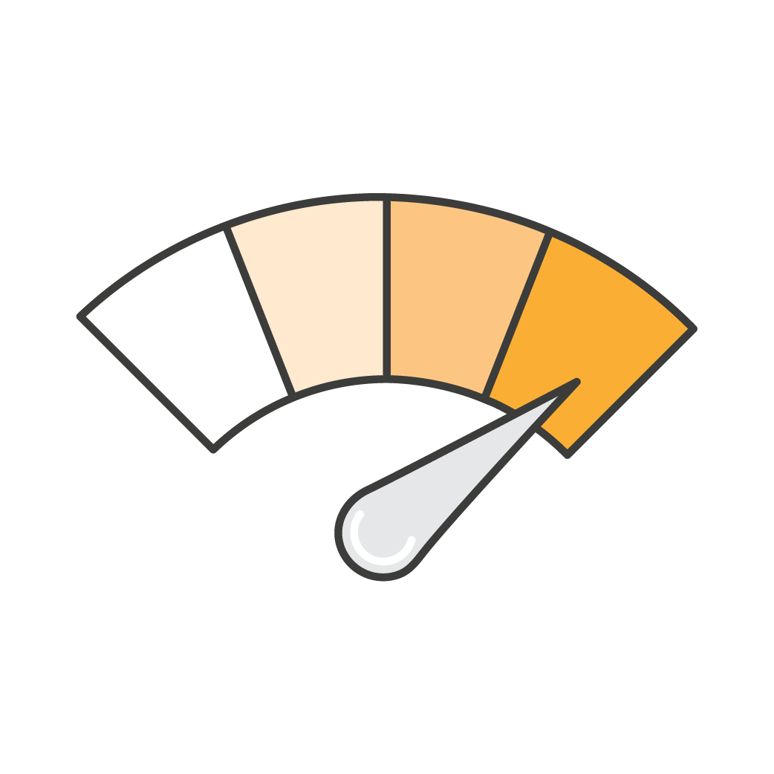

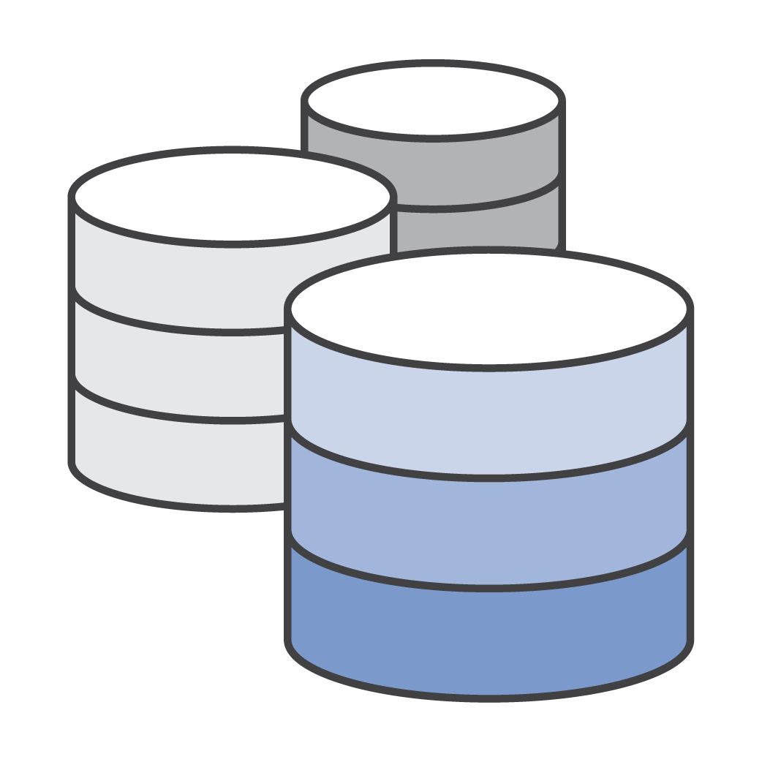





Using AWS Lambda
Bring your own code
Node.js, Java, Python, C#, Go
Bring your own libraries (even native ones)
Simple resource model
Select power rating from 128 MB to 3 GB
CPU and network allocated proportionately
Flexible use
Synchronous or asynchronous
Integrated with other AWS services
Flexible authorization
Securely grant access to resources and VPCs
Fine-grained control for invoking your functions
Notes:
Customers were running Go on Lambda before we added support. Likewise, customers have tested Fortran on Lambda. Can bring native libraries of your language.
Simple resource model – like a power button. One dial to get memory, CPU and network.

Slide 104


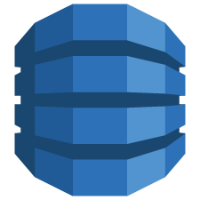
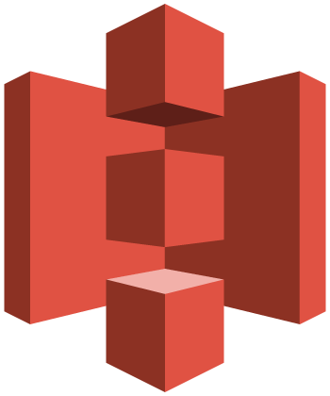


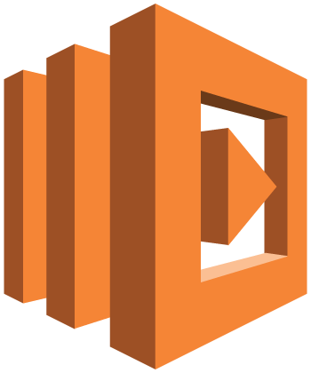
Lambda execution model
Synchronous (push)
Asynchronous (event)
Stream-based
Amazon API Gateway
Amazon
SNS
Amazon DynamoDB
Amazon
S3
Amazon Kinesis
/api/hello
reqs
changes
AWS Lambda service
AWS Lambda function
AWS Lambda function
function
Notes:
AWS Lambda polls the stream and invokes your Lambda function synchronously. After you do the necessary event source mapping, AWS Lambda polls the streams and invokes your Lambda function (referred to as the pull model)

Slide 105
Anatomy of a Lambda function
Handler() function
Function to be executed upon invocation
Event object
Data sent during Lambda Function Invocation
Context object
Methods available to interact with runtime information (request ID, log group, etc.)
public String handleRequest(Book book, Context context) { saveBook(book); return book.getName() + " saved!"; }
Notes:
Highlight the difference between JSON payload and runtime context information.

Slide 106
Lambda Functions Packaging

Slide 107

Meet SAM!

Slide 108
Serverless Application Model
CloudFormation extension optimized for serverless
New serverless resource types: functions, APIs, and tables
Supports anything CloudFormation supports
Open specification (Apache 2.0)
https://github.com/awslabs/serverless-application-model
Notes:
DSL on top of CFN
Done to simplify deployment of Serverless application

Slide 109
SAM Template
AWSTemplateFormatVersion: '2010-09-09' Transform: AWS::Serverless-2016-10-31 Description: Simple CRUD webservice. Resources: GetFunction: Type: AWS::Serverless::Function Properties: Handler: org.aws.samples.compute.greeting.GreetingHandler::handleRequest Runtime: java8 CodeUri: ./target/greeting.zip Policies: AmazonDynamoDBReadOnlyAccess Timeout: 30 Tracing: Active Environment: Variables: TABLE_NAME: !Ref Table Events: GetResource: Type: Api Properties: Path: /books Method: get Table: Type: AWS::Serverless::SimpleTable
}

Slide 110
SAM Commands
Package
Creates a deployment package (.zip file)
Uploads deployment package to an S3 bucket
Adds a CodeUri property with S3 URI
Deploy
Creates CloudFormation resources

Slide 111
SAM Local
Local testing of Serverless apps
Works with Lambda functions
Response object and function logs on local machine
Java, Node.js, Python, Go
C# coming
PRs welcome!
https://github.com/awslabs/aws-sam-local
Notes:
Uses opensource docker-lambda Docker image to mimic Lambda’s runtime environment. Emulates timeout, memory limits and runtimes. Does not emulate CPU limits. Partial API Gateway emulation (proxy calls).
Before proxy-style, developers have to transform the input/output formats using Velocity Template Language in order to be able to invoke Lambda functions. Amazon is a customer-obsessed company, so we listened to feedback and added a simple proxy-style.

Slide 112
Microservices using AWS Lambda
/greeting
/webapp
greeting
webapp
/names/1
name

Slide 113
Lambda Functions with SAM

Slide 114
Test and Debug Lambda

Slide 115
Lambda Best Practices

Slide 116
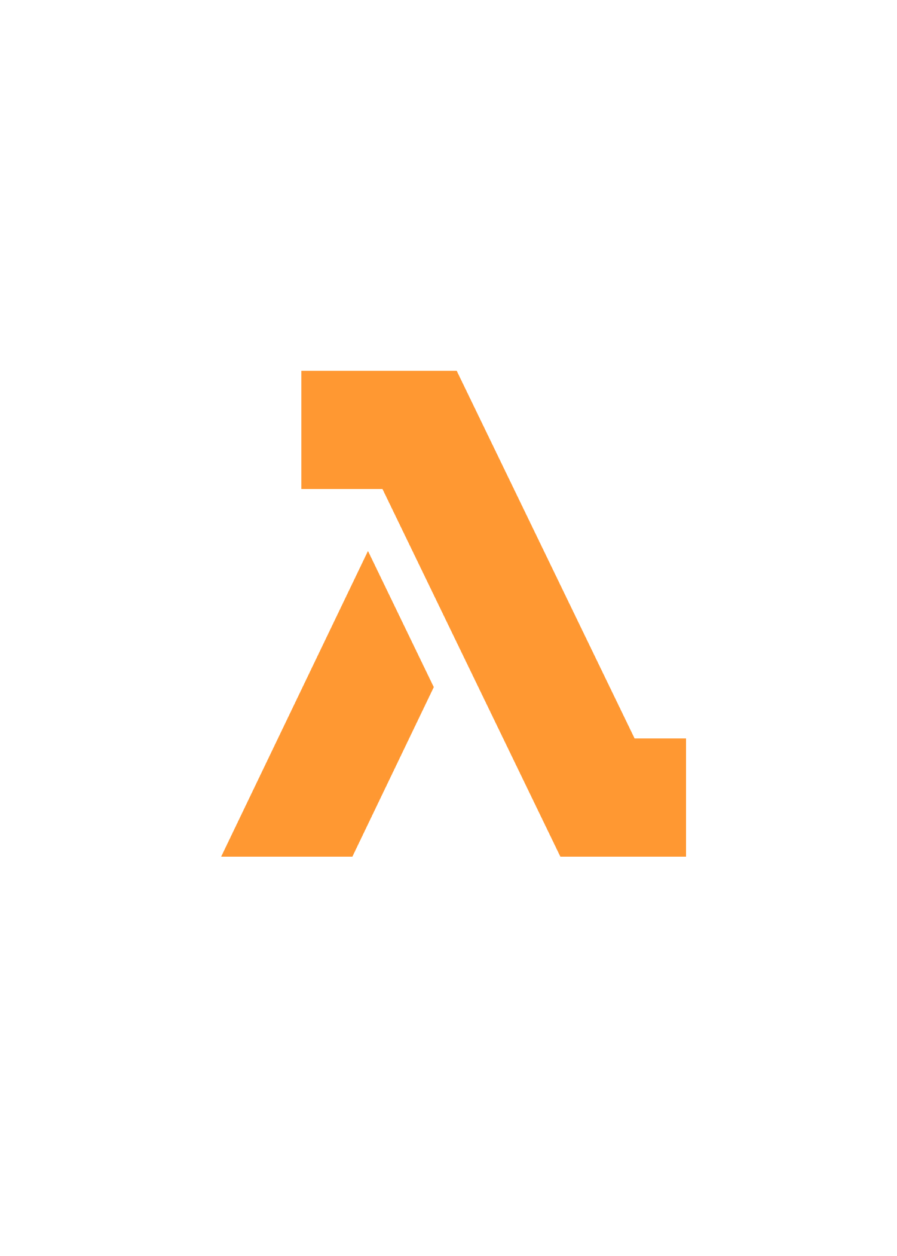
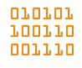
Lambda based “monoliths”
EVENT DRIVEN
ONE LARGE LAMBDA FUNCTION
GET /pets
PUT /pets
DELETE /pets
GET /describe/pet/$id
PUT /describe/pet/$id

Slide 117
Lambda based “monoliths”
EVENT DRIVEN
ONE LARGE LAMBDA FUNCTION
GET /pets
PUT /pets
DELETE /pets
GET /describe/pet/$id
PUT /describe/pet/$id

Slide 118

Lambda based “nano-services”
EVENT DRIVEN
ONE LAMBDA PER HTTP METHOD
GET /pets
PUT /pets
DELETE /pets
GET /describe/pet/$id
PUT /describe/pet/$id

Slide 119
Lambda Best Practices
Do handlers share code?
Split them into their own Lambda functions
Use language-specific packages to share code
Do functions share share event sources?
Split them in own code repos, with own SAM files
Locally validate SAM files before commit
Again in CI/CD process

Slide 120
Function Lifecycle
Download your code
Start new
container
Bootstrap
the runtime
Start your
code
Full Cold Start
Partial Cold Start
Warm Start
Full
cold start
AWS optimization
Your optimization

Slide 121
Lambda Best Practices
Separate the Lambda handler from core logic
public class BookPostHandler implements RequestHandler<Book, String> { static DynamoDBMapper mapper = DDBUtil.getMapper(); public String handleRequest(Book book, Context context) { System.out.println("Adding book: " + book); saveBook(book); return book.getName() + " saved!"; } private void saveBook(Book book) { mapper.save(book); } }
Notes:
This allows you to make a more unit-testable function.
Talk about 1000 concurrent execution and your database may not be able to handle this.

Slide 122
Lambda Best Practices
Minimize package size to necessities
<dependencies> <!-- https://mvnrepository.com/artifact/com.amazonaws/aws-lambda-java-core --> <dependency> <groupId>com.amazonaws</groupId> <artifactId>aws-lambda-java-core</artifactId> <version>1.1.0</version> </dependency> <!-- https://mvnrepository.com/artifact/com.amazonaws/aws-java-sdk-dynamodb --> <dependency> <groupId>com.amazonaws</groupId> <artifactId>aws-java-sdk-dynamodb</artifactId> <version>1.11.127</version> </dependency> </dependencies>
Notes:
This will reduce the amount of time that it takes for your deployment package to be downloaded and unpacked ahead of invocation. For functions authored in Java or .NET Core, avoid uploading the entire AWS SDK library as part of your deployment package. Instead, selectively depend on the modules which pick up components of the SDK you need (e.g. DynamoDB, Amazon S3 SDK modules and Lambda core libraries).

Slide 123
Lambda Best Practices
Use Environment Variables to modify operational behavior
String region = System.getenv("AWS_REGION");
. . .
String bucket = System.getenv("S3_BUCKET");
Notes:
Environment variables for Lambda functions enable you to dynamically pass settings to your function code and libraries, without making changes to your code. This allows a Lambda function to behave differently as it moves through lifecycle stages from development to deployment. Total set cannot exceed 4kb.
EC2 metadata API provides several environment variables, for example AWS_REGION.
For example, if you are writing to an Amazon S3 bucket, instead of hard-coding the bucket name you are writing to, configure the bucket name as an environment variable.
Environment variables are encrypted using AWS Key Management Service. Decrypted when accessed in the application.

Slide 124
Lambda Best Practices
Self-contain dependencies in your function package
<plugin> <groupId>org.apache.maven.plugins</groupId> <artifactId>maven-shade-plugin</artifactId> <version>3.1.0</version> <executions> <execution> <phase>package</phase> <goals> <goal>shade</goal> </goals> </execution> </executions> </plugin>
Notes:
Several versions of libraries are available but we may change and would not like customer’s applications to break

Slide 125
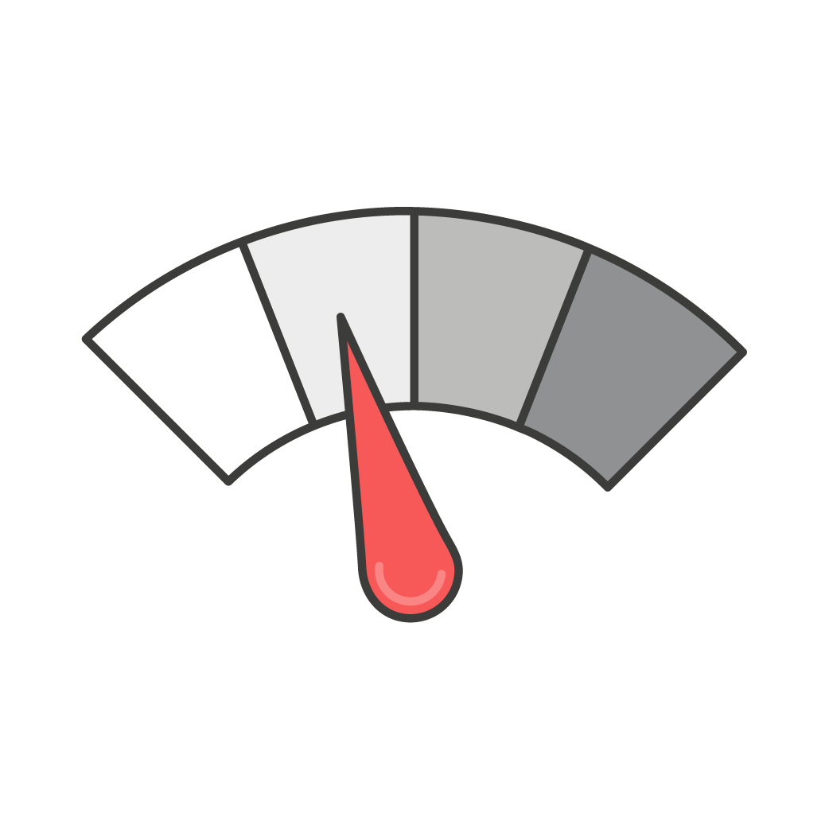
Computer power
> Memory > Cores
Lambda exposes only a memory control, this also affects the % of CPU core allocated to a function
Is your code CPU, Network or memory-bound, it could be cheaper to give more memory

Slide 126
Lambda Best Practices
Leverage “Max Memory Used” to right-size your functions
Calculate 1000x all prime numbers < 1m
Memory | Compute time | Cost
128 MB | 11.722965 secs | $0.024628
256 MB | 6.678945 secs | $0.028035
512 MB | 3.194954 secs | $0.026830
1024 MB | 1.465984sec | $0.024638
https://github.com/jconning/lambda-cpu-cost
Notes:
This is an example of what happens when you give more memory to a function: you also get more CPU and I/O capacity. This is a CPU-bound function (computing primes) so if you give more memory, it’ll be faster and finish earlier. Since you pay by the hundreds of milliseconds, if you give more memory and CPU you’ll get the results quicker, and pay almost the same!
Analogy of power button
Any increase in memory size triggers an equivalent increase in CPU available to your function. The memory usage for your function is determined per-invoke and can be viewed in AWS CloudWatch Logs. By analyzing the Max Memory Used: field, you can determine if your function needs more memory or if you over-provisioned your function's memory size.
The following table shows the average execution time and effective cost for a function executed with different memories, where each one was invoked 1,000 times. As we see, the effective cost goes down as CPU power increases, while the execution time at the highest memory size is aboutone tenth than at the lowest memory size.
Increasing the CPU power of a CPU-bound Lambda function reduces the duration without increasing the cost. Faster is cheaper in this case.

Slide 127
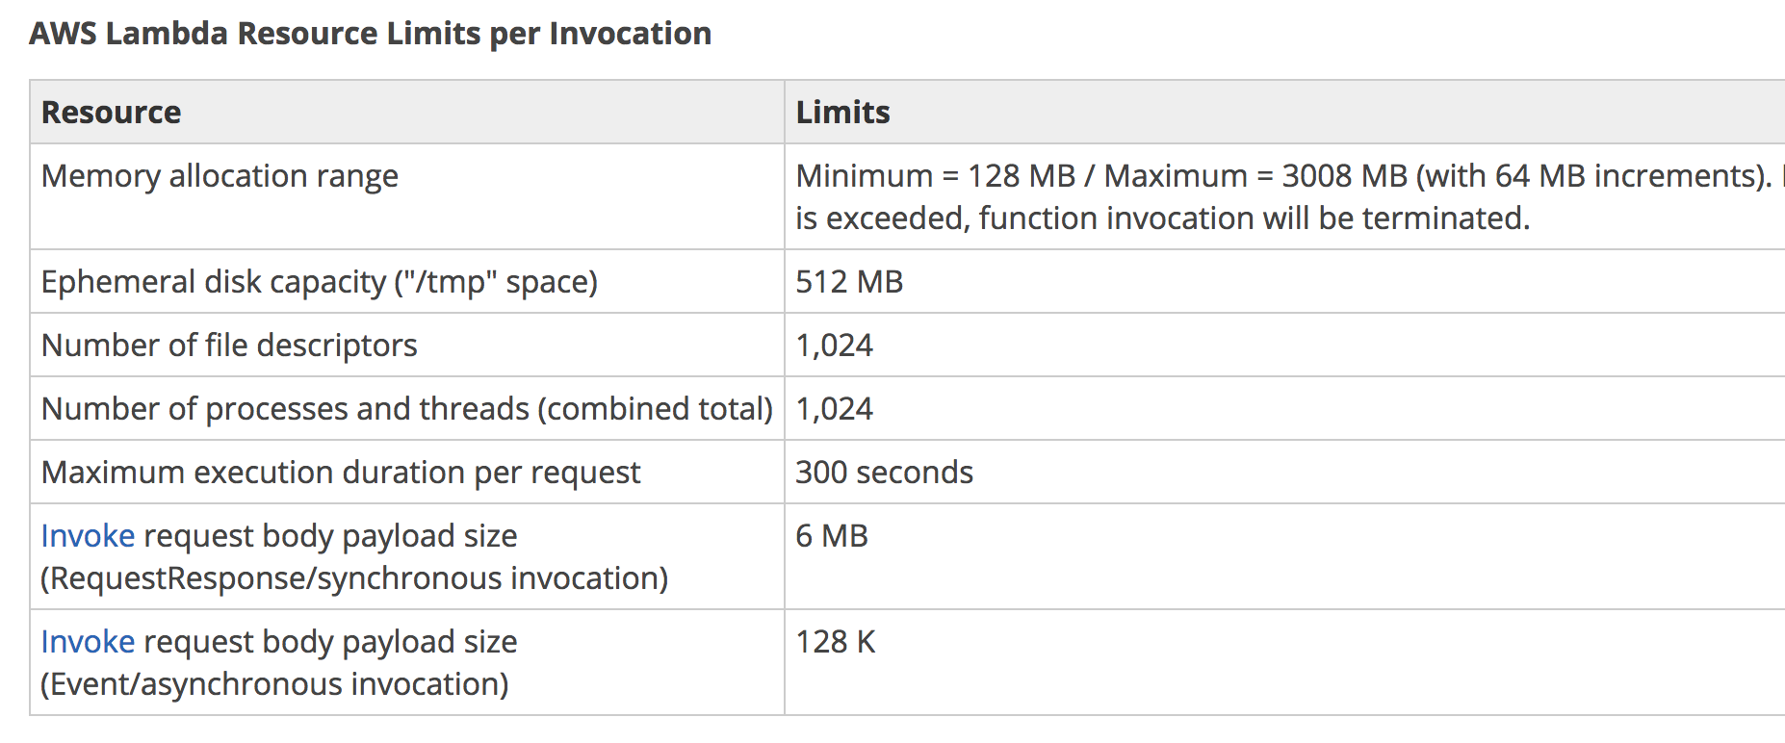
Lambda Best Practices
Delete large unused functions (75GB limit per region)
Notes:
Concurrent execution of 1000 functions, soft limit, can be increased by request

Slide 128
API Gateway Stage Variables

Slide 129
Aliases for Lambda Functions

Slide 130
Stage Variables and Lambda Aliases
Manage a single API configuration and Lambda function for multiple environment stages
myLambdaFunction
myAPI
1
2
3 = prod
4
5
6 = beta
7
8 = dev
Prod
lambdaAlias=prod
Beta
lambdaAlias=beta
Dev
lambdaAlias=dev

Slide 131
Traffic Shifting in Lambda Aliases
Apply a “weight” to Lambda function aliases to shift traffic between two versions
Create “canary” deploys
Do blue/green deployments between versions
See different metrics and logs
Test new functionality and rollback quickly

Slide 132
Canary Deployment Preference
CanaryXPercentYMinutes: X% traffic to new function, wait for Y minutes, shift all traffic
X = 10, Y = 5, 10, 15, 30
LinearXPercentEveryYMinutes: X% traffic every Y minutes
X = 10, Y = 1, 2, 3, 10
AllAtOnce: all traffic at one
Notes:
https://github.com/awslabs/serverless-application-model/blob/develop/docs/safe_lambda_deployments.rst
https://docs.aws.amazon.com/lambda/latest/dg/automating-updates-to-serverless-apps.html

Slide 133
Canary Deployments using SAM

Slide 134
Logging and Metrics are a universal right!
CloudWatch Metrics:
6 Built in metrics for Lambda
Invocation Count, Invocation duration, Invocation errors, Throttled Invocation, Iterator Age, DLQ Errors
Can call “put-metric-data” from your function code for custom metrics
7 Built in metrics for API-Gateway
API Calls Count, Latency, 4XXs, 5XXs, Integration Latency, Cache Hit Count, Cache Miss Count
Error and Cache metrics now support averages and percentiles

Slide 135
App Monitoring with AWS X-Ray and Serverless
Lambda instruments incoming requests for all supported languages
Lambda runs the X-Ray daemon on all languages with an SDK
var AWSXRay = require(‘aws-xray-sdk-core‘);
AWSXRay.middleware.setSamplingRules(‘sampling-rules.json’);
var AWS = AWSXRay.captureAWS(require(‘aws-sdk’));
S3Client = AWS.S3();
Notes:
Monitoring was kinda left out. Lambda got really popular, Lambda started with S3, added API Gateway. Customers had a lot of trouble debugging such applications, particularly with multiple functions. X-Ray is an instrument to debug your application at scale.
AWS X-Ray helps developers analyze and debug production, distributed applications, such as those built using microservices architecture. X-Ray provides an end-to-end view of requests as they travel through your application. and show a map of your underlying application component.
A request id is added to each request that is sent to the application, and is used for tracing and debugging.

Slide 136
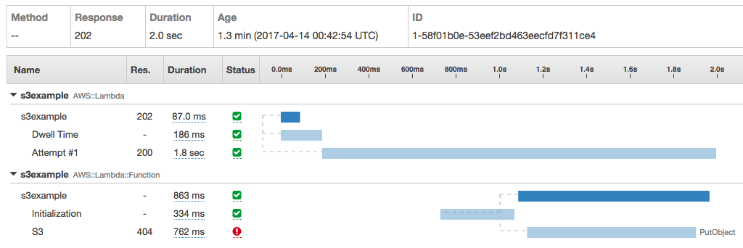
X-Ray Trace Example
Notes:
Create a Node.js application from X-R
This allows you to identify cold and warm start times for your application. For example, for Python it takes about 3 seconds and 10-12 seconds for a Java-based Lambda.

Slide 137
Monitoring Lambda with AWS X-Ray

Slide 138
Composing Lambda Functions

Slide 139

Event Processing
Event A on B triggers C
A
B
C
Invocation
Action
Lambda functions

Slide 140









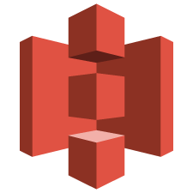
Event-driven platform
Invoked in response to events
Changes in data
Changes in state
Access any service, including your own
Any custom
S3 event notifications
DynamoDB Streams
Kinesis events
Such as…
SNS
DynamoDB
Lambda
SNS events
CloudTrail events
Cognito events
Lambda functions
Redshift
Kinesis
S3
Custom events
CloudWatch
events

Slide 141






Event-driven actions
S3:
Source Bucket
Lambda:
Resize Images
S3:
Destination Bucket
Triggered on
PUTs
Users upload photos
Notes:
A few years ago it was quite common for media companies to use FFMpeg to extract metadata from an image, resize, add more metadata, rename, and store it again. It was quite painful. It was one of the first usecases why Lambda came to life.

Slide 142
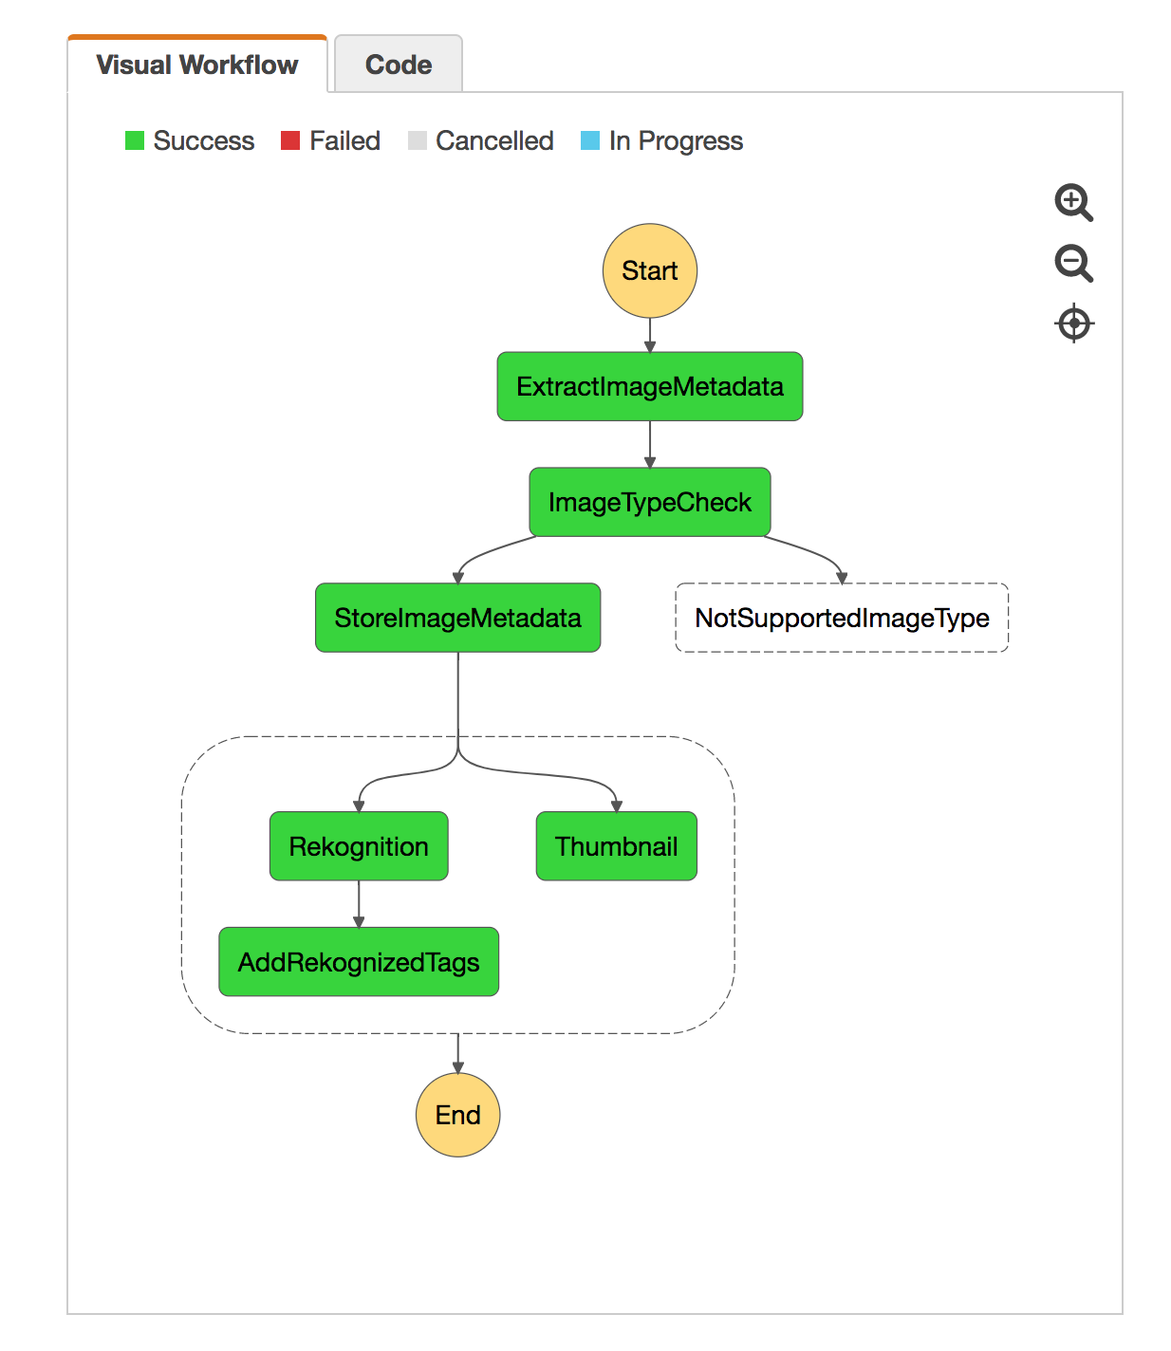
AWS Step Functions: Orchestrate a Serverless processing workflow using AWS Lambda
Notes:
Once the basic usecase was working, customers wanted to use Lambda in multiple ways. They would create different functions for different microservices, so to say. Now they needed a way to coordinate these functions together. So, if you’re triggering a Lambda function when a document is uploaded to S3 and that should trigger a series of other Lambda functions, then this requires a lot of custom wiring. So, we listen to customers and introduced Step Functions. Think of it as a state machine running in the cloud that you can control through an API.
Rekognition is very useful for customers that have very large media library and want to index it.
AWS Step Functions makes it easy to coordinate the components of distributed applications and microservices using visual workflows. It provides a graphical console to arrange and visualize the components of your application as a series of steps. This makes it simple and easy to run multistep applications. Step Functions automatically triggers and tracks each step, and retries when there are errors, so your application executes as expected.
Demo: https://github.com/awslabs/lambda-refarch-imagerecognition

Slide 143
Lambda Workflow
with AWS Step Functions

Slide 144
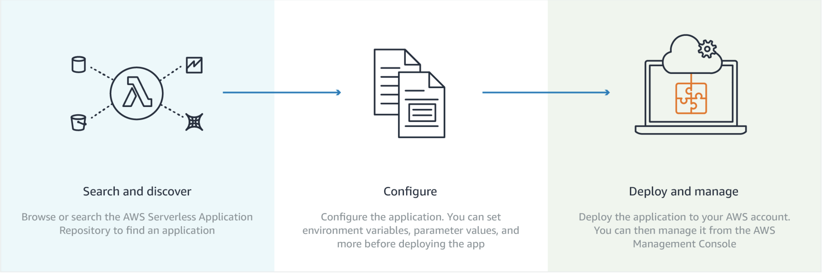
Serverless Application Repository

Slide 145
Serverless Application Repository

Slide 146
Further Reading
AWS Fargate & Amazon ECS
https://aws.amazon.com/ecs
https://aws.amazon.com/fargate
Serverless
https://aws.amazon.com/serverless/
Kubernetes
https://aws.amazon.com/eks

